Slide 1
CSCI2100E Chapter 1 Data Structures and Complexity

Slide 2



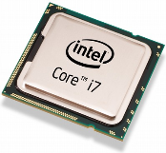
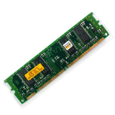
Programming Languages?
Natural Languages
Chinese, English, Japanese, …
Programming Languages (PLs)
High Level PLs
Pascal, C, Java, …
Low Level PLs
Assembly Languages
A Machine Language executed by a CPU
Programming: to tell what CPU to do step-by-step
2 + 3 = ?
Input/Output,
Get the answer (computing)
1-2

Slide 3
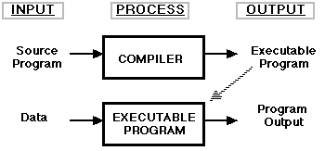
A Simple Example (1)
From where it starts?
What is a variable?
How many different types of variables?
Who writes printf? Where is it?
What is #include for?
Return 0? To whom?
#include <stdio.h>
int main()
{ int x, y, z;
x = 2;
y = 3;
z = x + y;
printf(“%d + %d = %d\n”, x, y, z);
return 0;
}

Slide 4
A Simple Example (2)
#include <stdio.h>
int main()
{ int x, y, z;
x = 2; y = 3; z = x + y;
printf(“%d + %d = %d\n”, x, y, z);
return 0;
}
What is a procedure?
#include <stdio.h>
int main()
{ int z;
z = add(2, 3);
printf(“%d + %d = %d\n”, 2, 3, z);
return 0;
}
int add(int x, int y) { return x + y;}

Slide 5
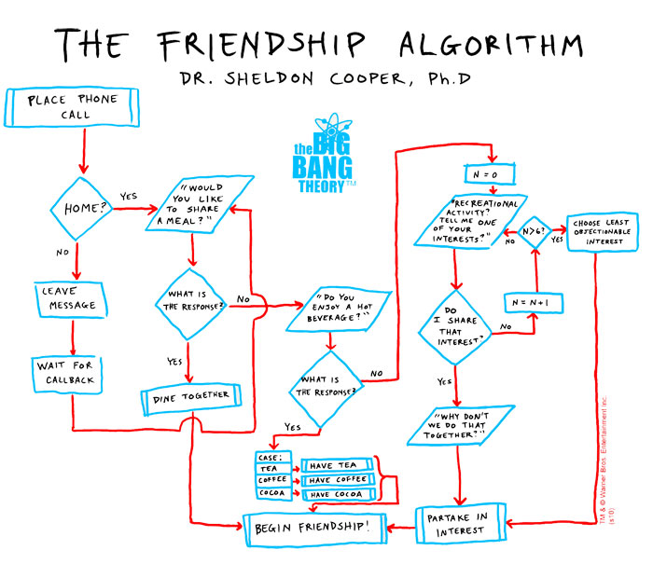
What is Algorithm?
1-5

Slide 6

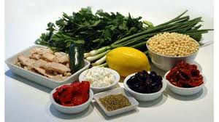
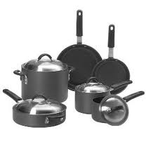
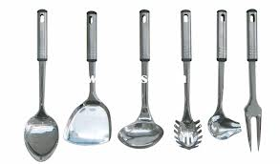
An Algorithm is Like a Recipe?
The ingredients
The equipment
The list of steps

Slide 7
Algorithm
An algorithm is a finite set of instructions that, if followed, accomplishes a particular task to solve a problem.
All algorithms satisfy the following criteria:
Input: 0 or more quantities are supplied.
Output: At least one quantity is produced.
Definiteness: Each instruction is clear and unambiguous.
Finiteness: For all cases, the algorithm terminates after a finite number of steps.
Effectiveness: Every instruction must be basic enough (feasible).

Slide 8
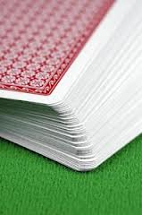

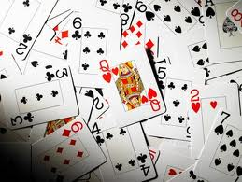
Basic Instructions?
Unlike human, one instruction can only do a very basic thing, check a data value, compare two data values, etc.
Consider sorting cards.
Human can quickly sort cards in order, because they can see all the cards simultaneously.
An algorithm cannot.

Slide 9
Data Types
Algorithms are to manipulate data.
A piece of datum represents something in the real world, such as a student number (integer), loan balance (real number), etc.
A data type is a notion used in programming languages, and is defined as a collection of objects (data values) and a set of operations that act on those objects.
For example, the integer data type
Values: -100, 0, 200, …
Operations: +, -, / (division), * (multiplication), etc.
In C programming language
int i, j, k;
i = 100; j = 20; k = i * j;
Programming languages provide basic data types such as integer, char, float, double, etc.

Slide 10
Data Structure
A data structure is a logical organization of data.
For a student record, the component elements are the fields. These fields describe different attributes of a student.
The C programming language provides two mechanisms for grouping objects (data values, or simply data) together: the structure and the array. E.g.
struct student {
char name[16];
int student_id;
};
struct student i, you, studentSociety[100];
i.student_id = 1234567;
you.student_id = 7654321;

Slide 11
Struct vs Array
Both struct and array are used to group objects together.
The struct is mainly used to group different objects together.
The student defined groups student name and student id together.
The array is mainly used to group same objects together.
An array groups a collection of students together.

Slide 12
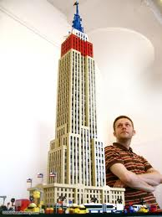
Building Large Data Structures
A data structure can be organized over some existing data structures hierarchically.
An example struct student {char name[16]; int student_id;};
struct course { char instructorName[16]; struct student students[100]; }; struct program { char programName[32]; struct course courses[60]; }; struct program FTEC;

Slide 13
User Defined Data Types (1)
A data structure is not a data type!
Questions:
Because the basic data types (e.g., char, int) are not enough, can we define data types we want to use by ourselves?
Answer:
In addition to the basic data types, we can consider any user-defined data structure, like the student example in the previous slide, as a user-defined data type by specifying a set of operations associated with the user-defined data structure.

Slide 14
User Defined Data Types (2)
Question/Answer:
Should the basic data types and the user-defined data types be treated in the same way?
The answer is yes. But, in reality, it depends on programming languages.
For a basic data type, for example integer, we must use the operations provided by a programming language.
We do not need to know how integers are represented in the main memory.
We do not need to know how the integer operations are implemented.
For a user-defined data type, we know it well but too much!
We know how it is represented in the main memory.
We also know how they are implemented.

Slide 15
User Defined Data Types (3)
What are wrong if we know too much?!
Answer:
We may write programs depending on our knowledge on the data representations and data manipulations heavily.
We cannot change a user-defined data type (its representation and/or its implementations) easily when needed. This is because we can not easily figure out how others use this data type.
Action:
We need to hide details! So developers cannot possibly know too much. (Very Important)

Slide 16

User Defined Data Types (4)
How to hide details?!
Answer:
Consider a user-defined data type X.
We must only use the operations associated with X to manipulate the X typed values.
We cannot access the X typed values in any other way!
No good to access a component of a data structure directly. struct student you; you.student_id = 7654321;

Slide 17
Abstract Data Types (ADT)
An ADT is a data type that is organized as follows.
The definition of the data values is separated from the representation of the data values.
The definition of the operations on the data values is separated from the implementation of the operations.
An ADT is for encapsulation (information hiding).
The implementation of an ADT and its operations can be localized to one section of the program.
Procedures that make use of the ADT can safely ignore its implementation details.

Slide 18
How to Separate?
How can the definition of operations of an ADT differ from the implementation of the operations?
The definition consists of names of every operation (function), the type of its arguments, and the type of its result. int setStudentID(struct student, int);
The definition does not reveal the internal representation or implementation details. struct student you; setStudentID(you, 7654321);
ADT is implementation-independent!

Slide 19
An ADT Example of Set
Data values: {1, 3, 5, 8}, {5, 8, 12}, ….
Operations: search(integer, set), intersection(set, set), union(set, set), etc.
The details
The representation: arrays or lists or ...
The implementation of operations: it can be implemented in many different ways depending on the data representation and the programming language used.

Slide 20
3 Types of Operations of ADT
Creator/Constructor:These operations create a new instance (value) of the data type. set createAnEmptySet();
Transformers: These operations also create an instance of the data type, generally by using one or more other instances. set union(set, set);
Observers: These operations provide information about an instance of the type, but they do not change the instance. void showMembers(set);

Slide 21
ADT Programming
An ADT can be built on some ADTs which can also be built on other ADTs as well.
A problem or an application in the real world can be considered as an user-defined ADT in a programming language.
Why? An ADT is a data type which is a set of data values plus a set of operations to manipulate these data.
Programming is to implement ADTs.
Easy to understand, code and debug -- readable, documented, modular.
Efficient use of the computing resources -- save storage.

Slide 22
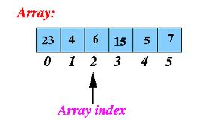
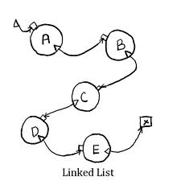

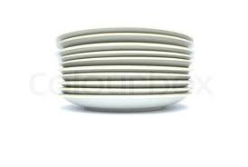
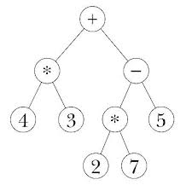
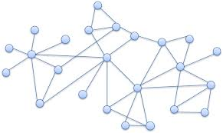
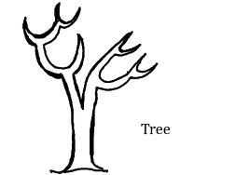
What Are The Common ADTs?
Lists, stacks, queues, trees, graphs, etc.
Group same objects together
The efficiency of ADTs
The data representation: data structures
The implementation of the operations: algorithms

Slide 23
A Summary on Data Types
Data Structure (Representation/Organization) + Operations = Data Type
Data Types
Basic Data Type provided by a programming Language
User Defined Data Type by programmers when needed
A User Defined Data Type can be built on other data types (either basic or user defined).
Abstract Data Types
Two Separations: The definition of the data values is separated from the representation of the data values.The definition of the operations on the data values is separated from the implementation of the operations. An ADT is for encapsulation (information hiding).

Slide 24
Programming Language Support for ADTs
Object-oriented programming languages, e.g. C++, Java (via the concept of class)
C does not have an explicit mechanism for implementing ADTs. But it is still possible and desirable to design ADTs using C.

Slide 25
An Example (1)
Suppose that we use an array of integers as the data structure to support the integer set ADT.
Consider how to implement the search operation:
int search(int set[], int searchnum, int size);
which returns the location i of the searchnum to be searched if set[i] == searchnum, otherwise returns -1.
We give two algorithms to implement it.

Slide 26
An Example (2): Linear Search
Assume sets of integers are unsorted. int search(int set[], int searchnum, int size){ int i; for (i = 0; i < size; i++) if (set[i] == searchnum) return i; return -1; }

Slide 27
An Example (3) Binary Search
Assume sets of integers are sorted
int search(int set[], int searchnum, int size) {
int left, right, middle;
left = 0;
right = size - 1;
while (left <= right) {
middle = (left + right) / 2;
if (set[middle] < searchnum)
left = middle + 1;
else if (set[middle] > searchnum)
right = middle - 1;
else return middle;
}
return -1;
}

Slide 28
searchnum = 18 size = 9
3
7
9
12
13
18
20
23
27
left=0
right=8
3
7
9
12
13
18
20
23
27
mid=4
left=5
right=8
3
7
9
12
13
18
20
23
27
mid=6
left=5
right=5
3
7
9
12
13
18
20
23
27
mid=5

Slide 29
searchnum = 28 size = 9
3
7
9
12
13
18
20
23
27
left=0
right=8
3
7
9
12
13
18
20
23
27
mid=4
left=5
right=8
3
7
9
12
13
18
20
23
27
mid=6
left=7
right=8
3
7
9
12
13
18
20
23
27
mid=7
left=8
right=8
3
7
9
12
13
18
20
23
27
mid=8

Slide 30
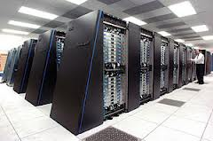

How to Measure Algorithms?
The binary search algorithm seems better than the linear search algorithm. But how can we say so?
Let’s run it, and see which one finishes less execution time (clocking time).
On which machine? The same or different machines?
The same/different programming language?
Different implementations?
Which compiler?
Which operating system?
This is performance measurement (Machine Dependent)

Slide 31
Performance Analysis
Performance Analysis is Machine Independent
The space complexity of a program is the amount of memory that it needs to run to completion.
The time complexity of a program is the amount of computer time that it needs to run to completion.
How do we analyze a program?
Count the number of steps.
What is a step?
A program step is a syntactically or semantically meaningful program segment whose execution time is independent of the instance characteristics.
How do we count the number of steps?
The number of steps depends on the instance characteristics.

Slide 32
An Example
int sum(int set[], int n)
{
int tempsum;
int i;
tempsum = 0; /* step/execution 1 */
for (i = 0; i < n; i++) /* step/execution n+1 */
tempsum += set[i]; /* step/execution n */
return tempsum; /* step/execution 1 */
}
Instance characteristics of this program : n
The total number of steps is 2n + 3 by counting the number of statements.
In general, instance characteristics can be: # of inputs, # of outputs, magnitude of inputs and outputs, etc..
Need to consider the important instance characteristics.

Slide 33
The Size of Data Values (Instance Characteristics)
What is the size of data values? For example, as for the integer set ADT, it is the number of elements.
Why do we need to consider the size of data values?
The number of steps to be executed is related to the size of input data values.
int search(int set[], int searchnum, int size){
int i;
for (i = 0; i < size; i++)
if (set[i] == searchnum) return i;
return -1;}
search(smallSet, 88, 100);
search(largeSet, 88, 100000);
The number of steps depends on where the searchnum value is in the given integer set.
Best-case analysis, Worst-case analysis, On-average analysis

Slide 34
Best-case, Worst-case, and Average-case Analysis
Best-case analysis:
The minimum # of steps that can be executed for the given input parameters.
Worst-case analysis:
The maximum # of steps that can be executed for the given input parameters.
Average-case analysis:
The average # of steps executed on instances with the given parameters.
Our focus: Worst-case analysis

Slide 35
Worst-Case Analysis: Linear search
Given an integer set which has n integers.
The set doesn't keep the integer searchnum.
The problem size is n (the size of the array).
int search(int set[], int searchnum, int size)
{
int i;
for (i = 0; i < size; i++) /* n+1 times */
if (set[i] == searchnum) /* n times */
return i; /* 1 times */
return -1; /* 1 times */
}
The total number of steps is 2n + 3.
This is a simple straightforward count – not all the steps are necessarily being executed during a particular run.

Slide 36
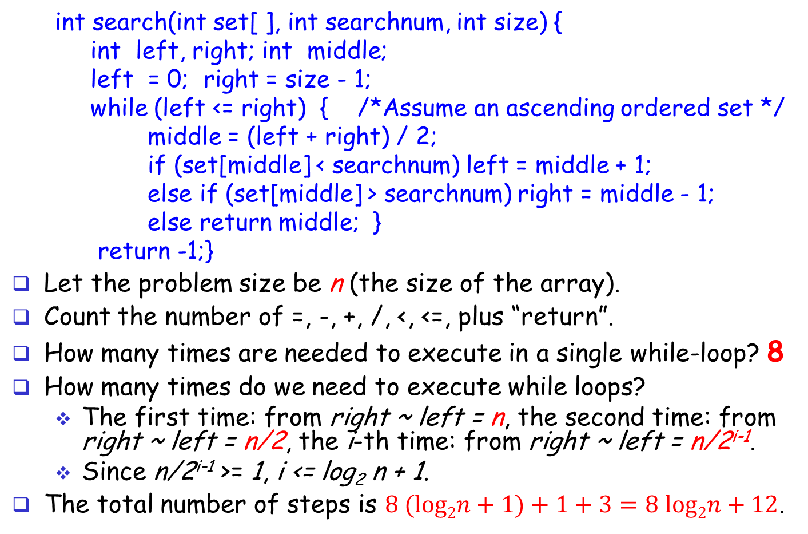
Worst-case Analysis: Binary Search
int search(int set[ ], int searchnum, int size) {
int left, right; int middle;
left = 0; right = size - 1;
while (left <= right) { /*Assume an ascending ordered set */
middle = (left + right) / 2;
if (set[middle] < searchnum) left = middle + 1;
else if (set[middle] > searchnum) right = middle - 1;
else return middle; }
return -1;}
Let the problem size be n (the size of the array).
Count the number of =, -, +, /, <, <=, plus “return”.
How many times are needed to execute in a single while-loop? 8
How many times do we need to execute while loops?
The first time: from right ~ left = n, the second time: from right ~ left = n/2, the i-th time: from right ~ left = n/2^{i-1}.
Since n/2^{i-1} >= 1, i <= log₂ n + 1.
The total number of steps is $8 (log2n+1)+1+3=8 log2n+12$.

Slide 37
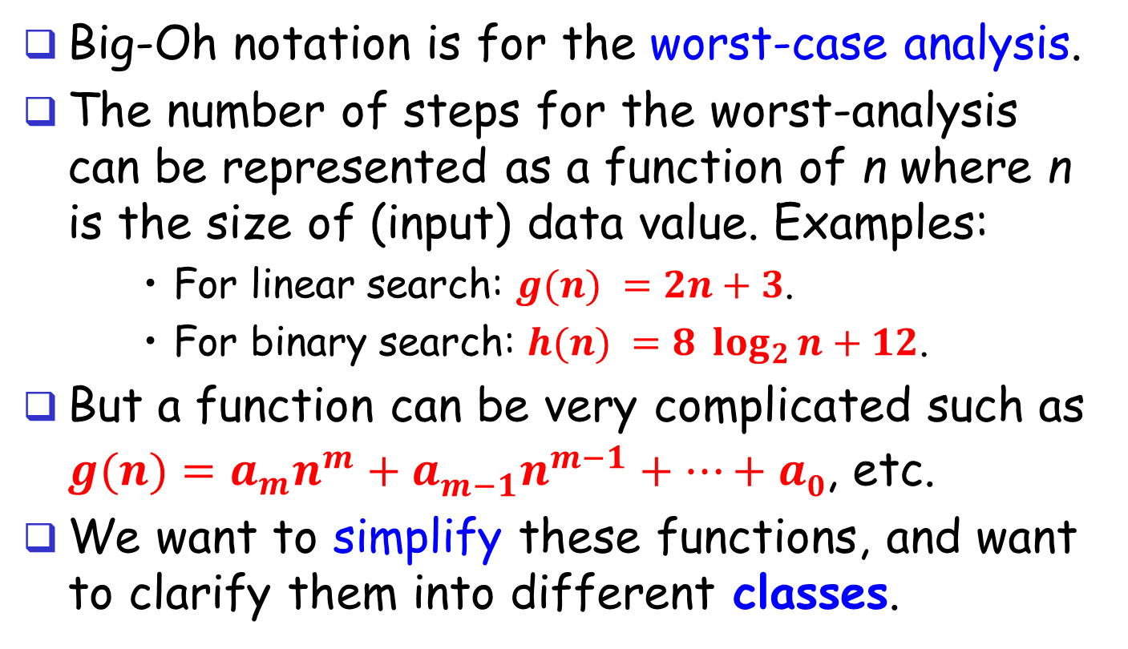
Big-Oh Notation (1)
Big-Oh notation is for the worst-case analysis.
The number of steps for the worst-analysis can be represented as a function of n where n is the size of (input) data value. Examples:
For linear search: $g(n) =2n+3$.
For binary search: $h(n) =8 \log_{2}{n}+12$.
But a function can be very complicated such as $g(n)=a_{m}n^{m}+a_{m−1}^{}n^{m−1}+…+a0$, etc.
We want to simplify these functions, and want to clarify them into different classes.

Slide 38
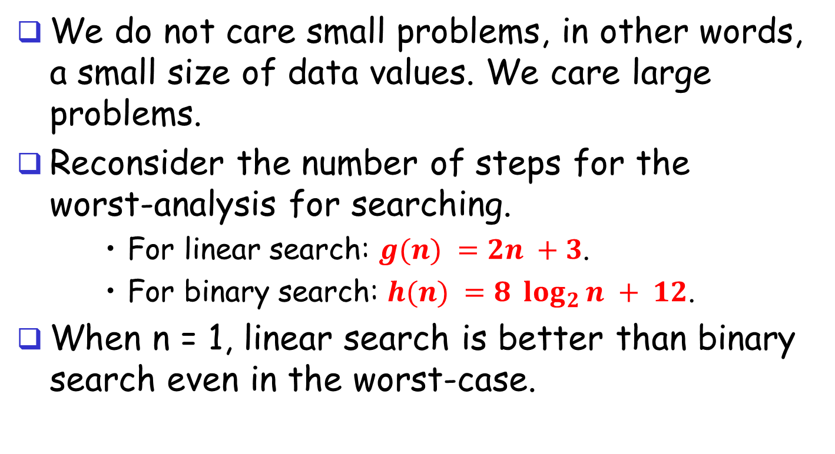
Big-Oh Notation (2)
We do not care small problems, in other words, a small size of data values. We care large problems.
Reconsider the number of steps for the worst-analysis for searching.
For linear search: $g(n) =2n +3$.
For binary search: $h(n) =8 \log_{2}{n} + 12$.
When n = 1, linear search is better than binary search even in the worst-case.

Slide 39
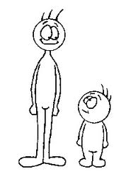
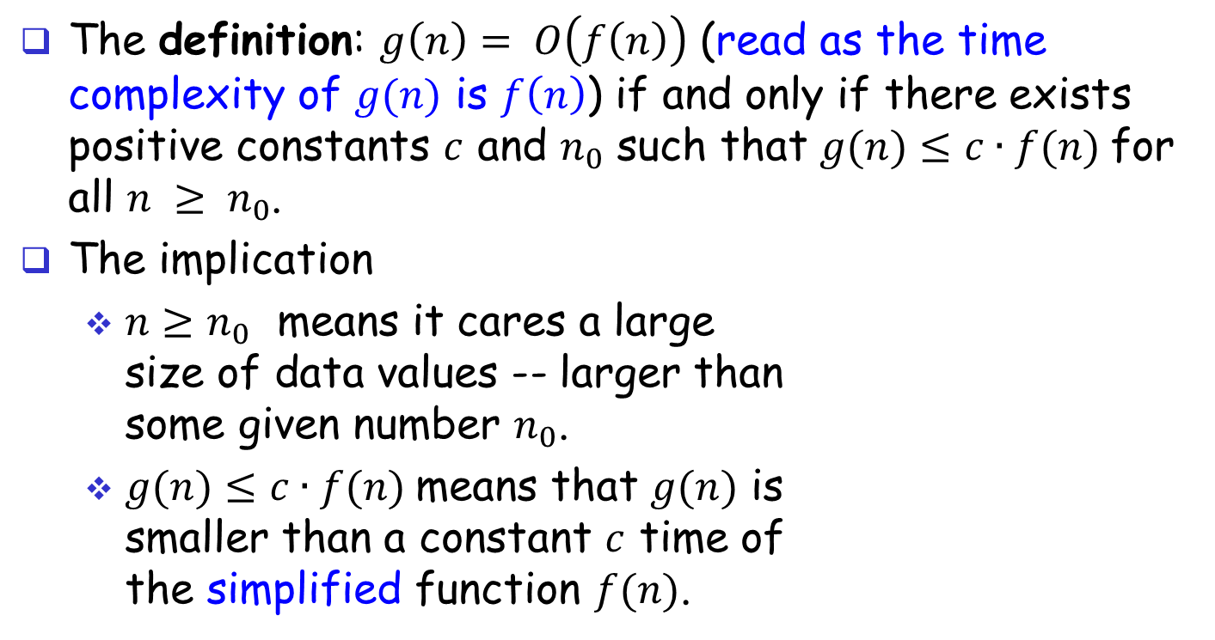
Big-Oh Notation (3)
The definition: $g\left(n\right)= O\left(f\left(n\right)\right)$ (read as the time complexity of $g(n)$ is $f\left(n\right)$) if and only if there exists positive constants $c$ and $n_{0}$ such that $g(n)≤c∙f(n)$for all $n ≥ n_{0}$.
The implication
$n≥n_{0}$ means it cares a large size of data values -- larger than some given number $n_{0}$.
$g(n)≤c∙f(n)$means that $g(n)$ is smaller than a constant $c$ time of the simplified function $f(n)$.

Slide 40
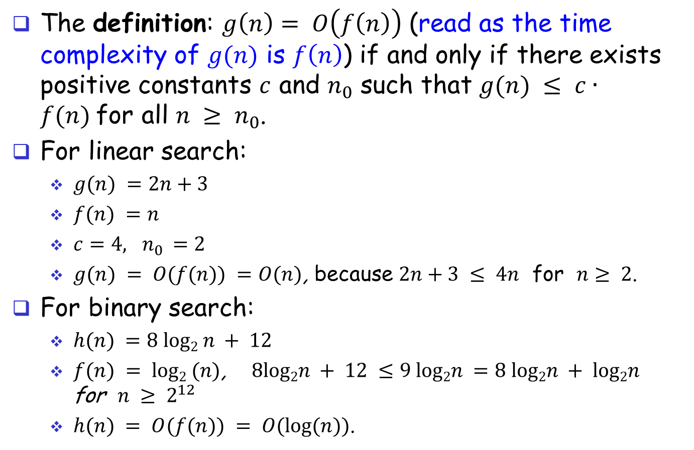
Big-Oh Notation (4)
The definition: $g\left(n\right)= O\left(f\left(n\right)\right)$ (read as the time complexity of $g(n)$ is $f\left(n\right)$) if and only if there exists positive constants $c$ and $n_{0}$ such that $g(n) ≤ c∙f(n)$for all $n ≥ n_{0}$.
For linear search:
$g(n) =2n+3$
$f(n) =n$
$c=4, n_{0} =2$
$g(n) = O(f(n)) =O(n)$, because $2n+3 ≤ 4n$ for $n≥ 2$.
For binary search:
$h(n) =8 log2 n + 12$
$f(n) = log2 (n)$, $8log2n + 12 ≤9 log2n =8 log2n + log2n$ for $n ≥ 2^{12}$
$h(n) = O(f(n)) = O(log⁡(n))$.

Slide 41
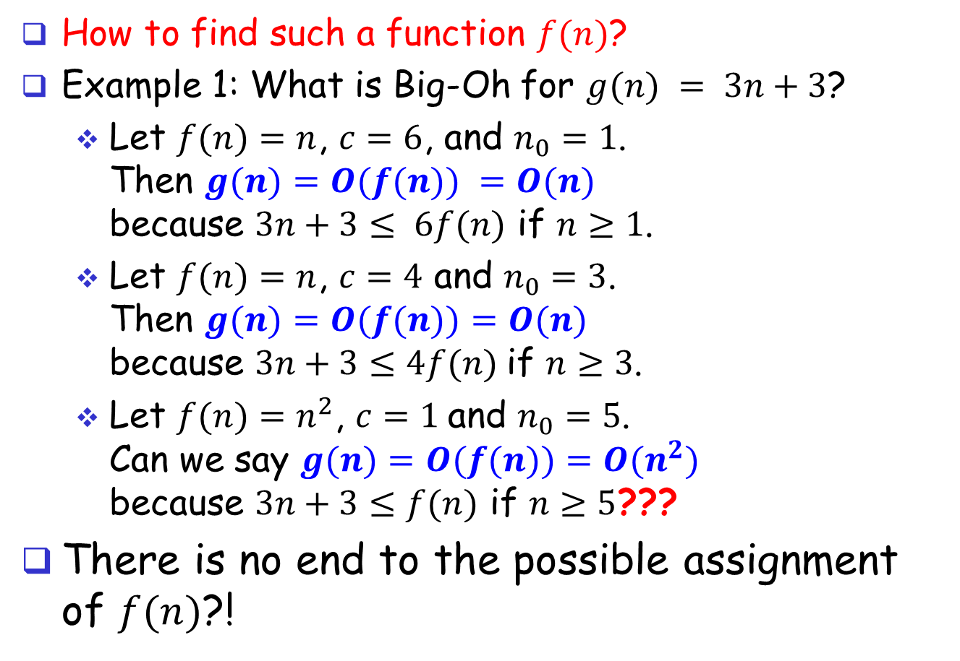
Big-Oh Notation (5)
How to find such a function $f(n)$?
Example 1: What is Big-Oh for $g(n) = 3n+3$?
Let $f(n)=n$, $c=6$, and $n_{0}=1$. Then $g(n)=O(f(n)) =O(n)$ because $3n+3≤ 6f(n)$ if $n≥1$.
Let $f(n)=n$, $c=4$ and $n_{0}=3$. Then $g(n)=O(f(n))=O(n)$ because $3n+3≤4f(n)$if $n≥3$.
Let $f(n)=n^{2}$, $c=1$and $n_{0}=5$. Can we say $g(n)=O(f(n))=O(n^{2})$ because $3n+3≤f(n)$ if $n≥5$???
There is no end to the possible assignment of $f(n)$?!

Slide 42
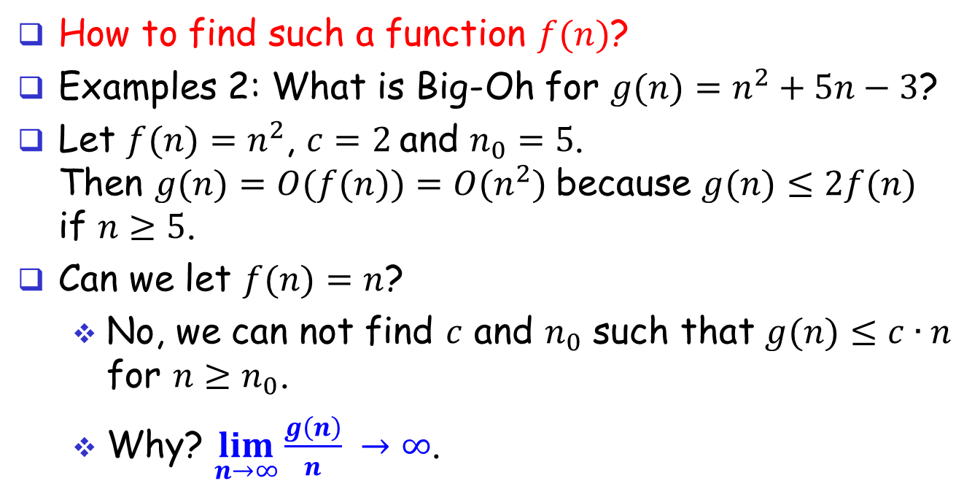
Big-Oh Notation (6)
How to find such a function $f(n)$?
Examples 2: What is Big-Oh for $g(n)=n^{2}+5n−3$?
Let $f(n)=n^{2}$, $c=2$and $n_{0}=5$. Then $g(n)=O(f(n))=O(n^{2})$because $g(n)≤2f(n)$ if $n≥5$.
Can we let $f(n)=n$?
No, we can not find $c$ and $n_{0}$ such that $g(n)≤c∙n$ for $n≥n_{0}$.
Why? $\lim_{n→∞}{\frac{g\left(n\right)}{n}} →∞$.

Slide 43
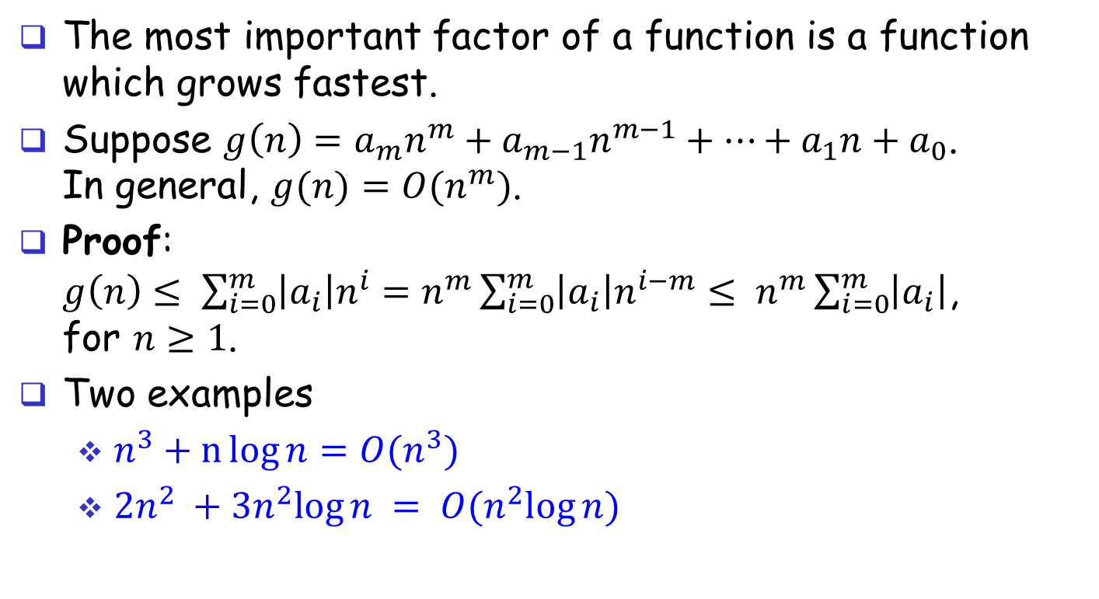
Big-Oh Notation: Most Important Factor (1)
The most important factor of a function is a function which grows fastest.
Suppose $g\left(n\right)=a_{m}n^{m}+a_{m−1}n^{m−1}+…+a_{1}n+a_{0}$. In general, $g(n)=O(n^{m})$.
Proof: $g\left(n\right)≤ \sum_{i=0}^{m}{\left|a_{i}\right|n^{i}}=n^{m}\sum_{i=0}^{m}{\left|a_{i}\right|n^{i−m}}≤ n^{m}\sum_{i=0}^{m}{\left|a_{i}\right|}$, for $n≥1$.
Two examples
$n^{3}+n\log{n=O(n^{3})}$
$2n^{2} +3n^{2}log⁡n = O(n^{2}log⁡n)$

Slide 44
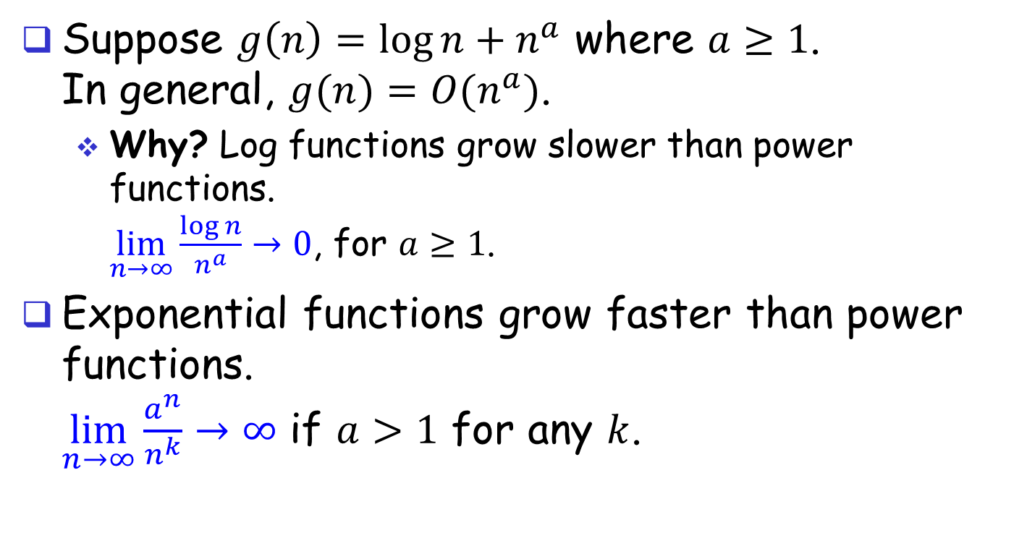
Big-Oh Notation: Most Important Factor (2)
Suppose $g\left(n\right)=\log{n}+n^{a}$ where $a≥1$. In general, $g(n)=O(n^{a})$.
Why? Log functions grow slower than power functions. $\lim_{n→∞}{\frac{\log{n}}{n^{a}}→0}$, for $a≥1$.
Exponential functions grow faster than power functions. $\lim_{n→∞}{\frac{a^{n}}{n^{k}}}→∞$ if $a>1$ for any $k$.

Slide 45
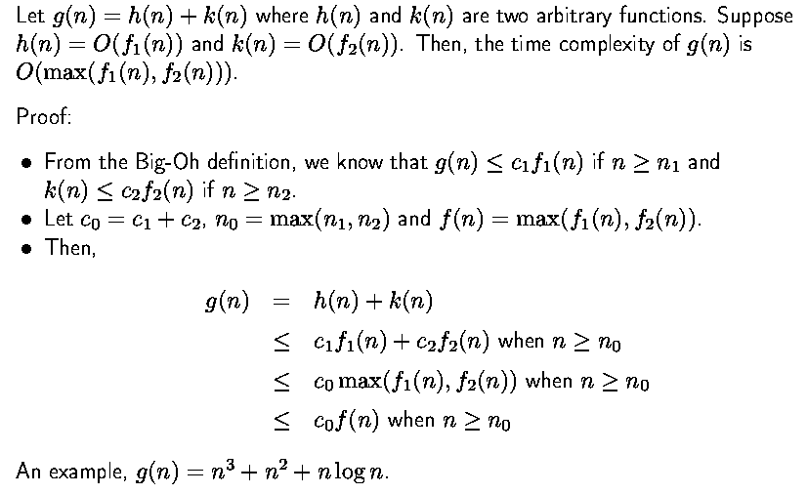
Big-Oh Notation: The Maximum Rule
h

Slide 46

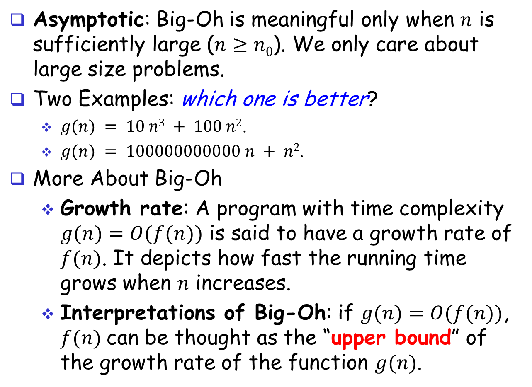
Big-Oh Notation: Asymptotic
Asymptotic: Big-Oh is meaningful only when $n$ is sufficiently large ($n≥n0$). We only care about large size problems.
Two Examples: which one is better?
$g(n) = 10 n3 + 100 n2$.
$g(n) = 100000000000 n + n2$.
More About Big-Oh
Growth rate: A program with time complexity $g(n)=O(f(n))$ is said to have a growth rate of $f(n)$. It depicts how fast the running time grows when $n$ increases.
Interpretations of Big-Oh: if $g(n)=O(f(n))$, $f(n)$can be thought as the “upper bound” of the growth rate of the function $g(n)$.

Slide 47
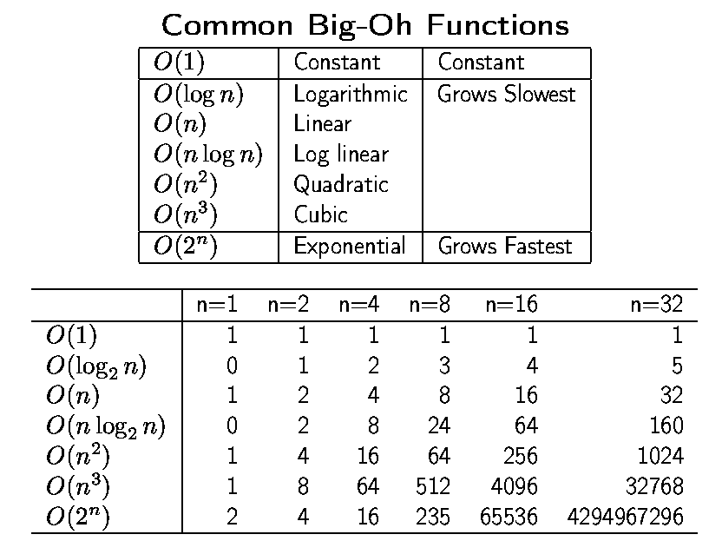
Common Big-Oh Functions/Classes

Slide 48
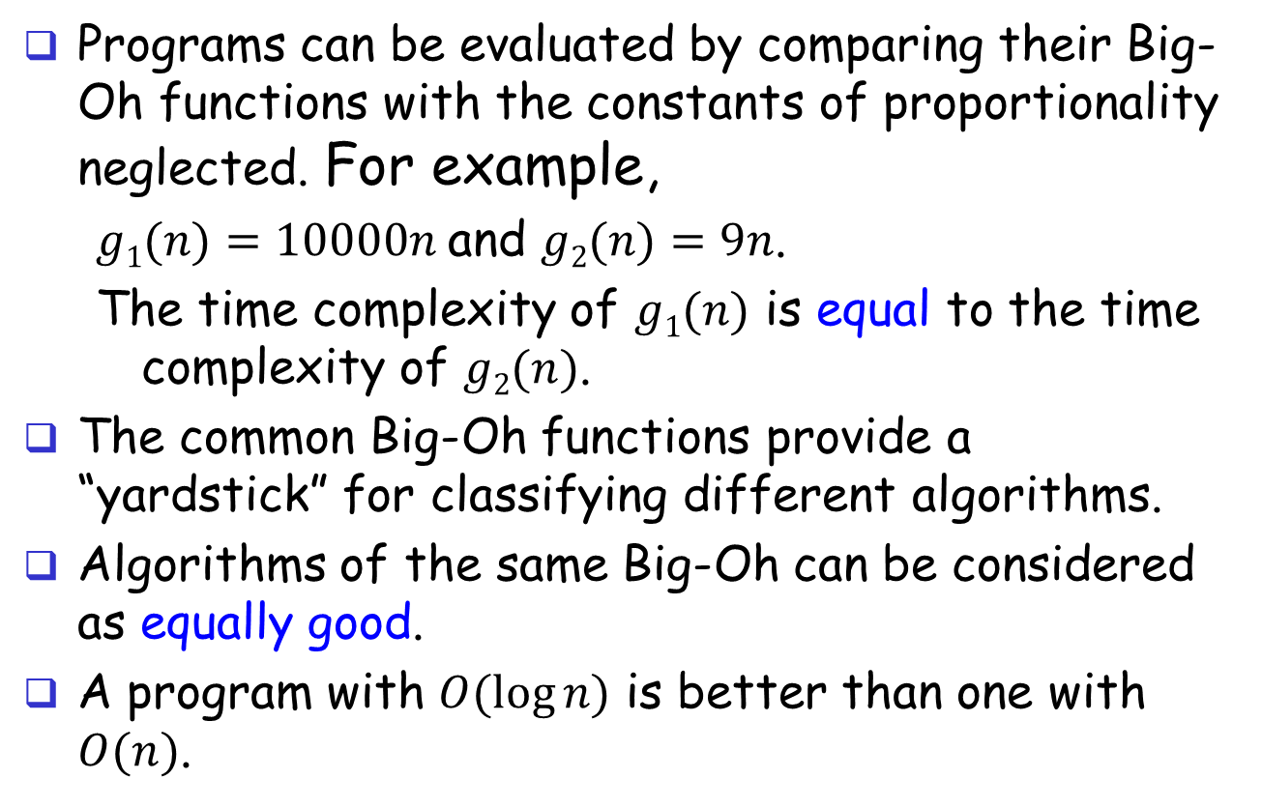
How do we use Big-Oh?
Programs can be evaluated by comparing their Big-Oh functions with the constants of proportionality neglected. For example,
$g1(n)=10000n$and $g2(n)=9n$.
The time complexity of $g1(n)$ is equal to the time complexity of $g2(n)$.
The common Big-Oh functions provide a “yardstick” for classifying different algorithms.
Algorithms of the same Big-Oh can be considered as equally good.
A program with $O(log⁡n)$ is better than one with $O(n)$.

Slide 49
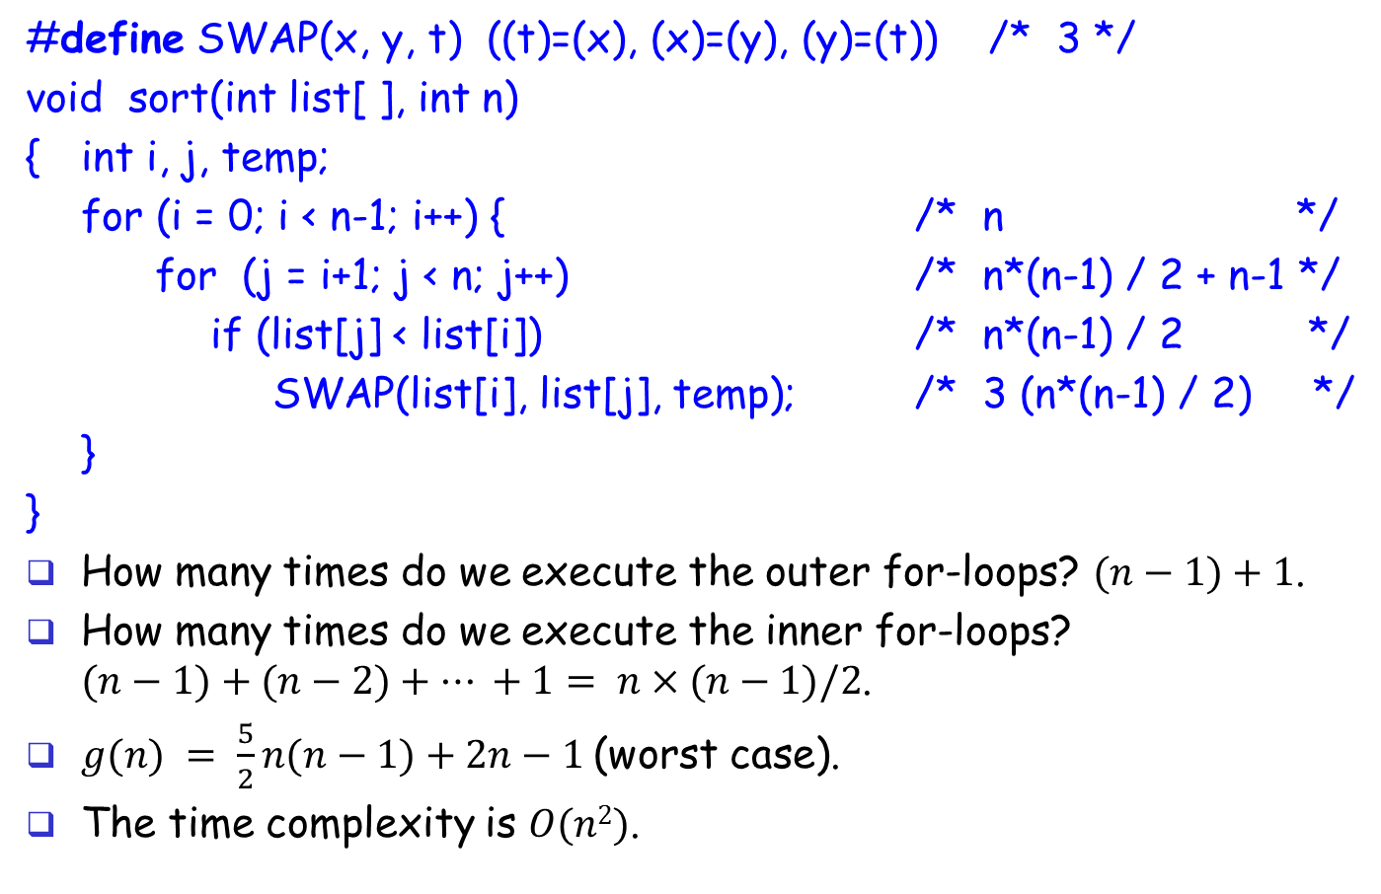
Simple Sort
#define SWAP(x, y, t) ((t)=(x), (x)=(y), (y)=(t)) /* 3 */
void sort(int list[ ], int n)
{ int i, j, temp;
for (i = 0; i < n-1; i++) { /* n */
for (j = i+1; j < n; j++) /* n*(n-1) / 2 + n-1 */
if (list[j] < list[i]) /* n*(n-1) / 2 */
SWAP(list[i], list[j], temp); /* 3 (n*(n-1) / 2) */
}
}
How many times do we execute the outer for-loops? $(n−1)+1$.
How many times do we execute the inner for-loops? $(n−1)+(n−2)+… +1= n×(n−1)/2$.
$g(n) = \frac{5}{2}n(n−1)+2n−1$(worst case).
The time complexity is $O(n2)$.
Notes:
D/E-class 20060118 Wed

Slide 50
Simple Sort Example: (n = 5)
i=0
5
4
3
2
1
j=1
4
5
3
2
1
j=2
3
5
4
2
1
j=3
2
5
4
3
1
j=4
1
5
4
3
2
i=1
j=2
1
5
4
3
2

Slide 51
Simple Sort Example: (n = 5)
i=1
1
5
4
3
2
j=2
1
4
5
3
2
j=3
1
3
5
4
2
j=4
1
2
5
4
3
i=2
j=3
1
2
5
4
3

Slide 52
Simple Sort Example: (n = 5)
i=2
1
2
5
4
3
j=3
1
2
4
5
3
j=4
1
2
3
5
4
i=3
1
2
3
5
4
j=4
1
2
3
4
5

Slide 53
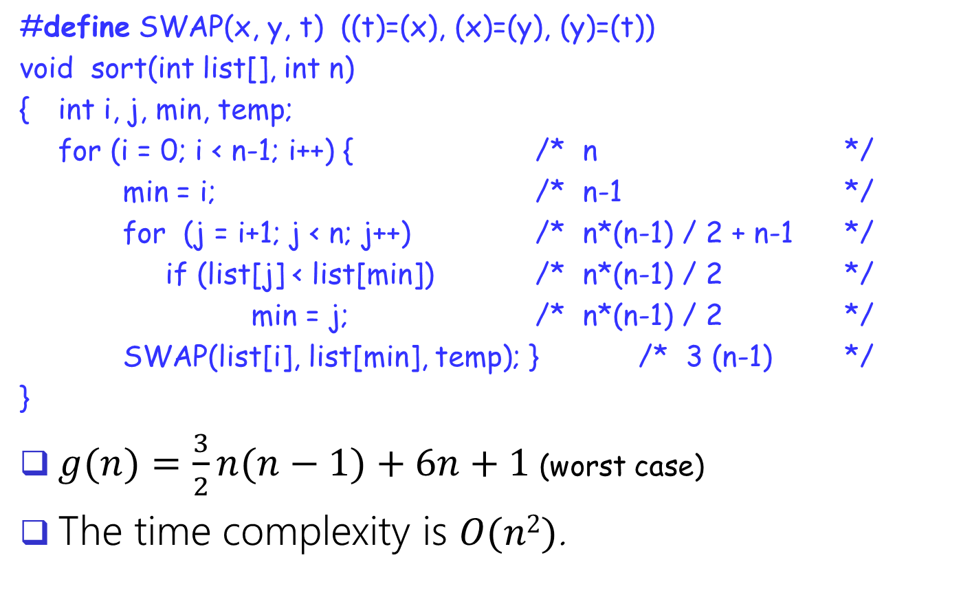
Selection Sort
#define SWAP(x, y, t) ((t)=(x), (x)=(y), (y)=(t))
void sort(int list[], int n)
{ int i, j, min, temp;
for (i = 0; i < n-1; i++) { /* n */
min = i; /* n-1 */
for (j = i+1; j < n; j++) /* n*(n-1) / 2 + n-1 */
if (list[j] < list[min]) /* n*(n-1) / 2 */
min = j; /* n*(n-1) / 2 */
SWAP(list[i], list[min], temp); } /* 3 (n-1) */
}
$g(n)=\frac{3}{2}n(n−1)+6n+1$(worst case)
The time complexity is $O(n2)$.

Slide 54
Selection Sort Example: (n = 5)
i=0
3
4
2
5
1
min=4
1
4
2
5
3
i=1
min=2
1
2
4
5
3
i=2
min=4
1
2
3
5
4
i=3
min=4
1
2
3
4
5

Slide 55
Pseudo Code in English
To express the problem solving sequence logically using plain language (e.g. English) with the help of the control structures of the programming language to be used.
State:
Problem to be solved using English
Idea (how to solve it)
Input/output specification of the program segment
Algorithm:
Control structures specification
Detail descriptions in English or Mathematical Expressions
verification

